Slide 1
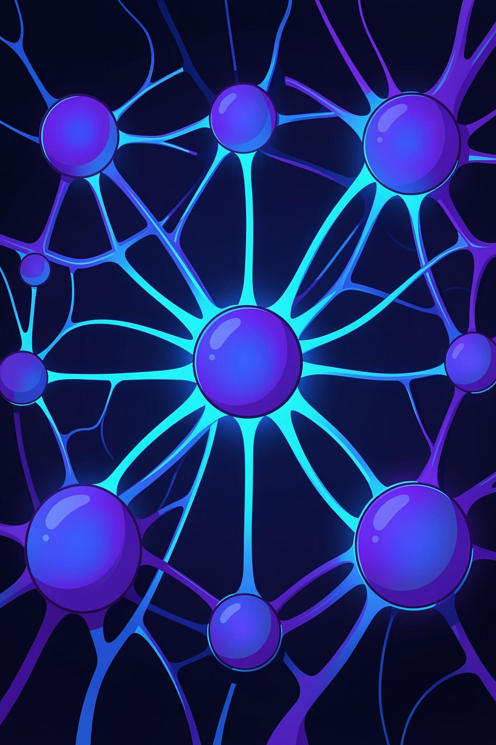
Medical Verifier System
An AI-powered framework for validating medical reasoning in multiple- choice questions — ensuring correctness, transparency, and logical consistency across every step of clinical explanation.
DIAGNOSTIC REASONING · AI VERIFICATION · CLINICAL EDUCATION

Slide 2

The Core Problem
Large language models produce fluent, confident prose — but fluency is not validity. In the medical domain, errors in reasoning can be subtle, consequential, and hard to detect.
Logical Gaps
Missing intermediate steps leave conclusions unsupported by stated premises.
Wrong Assumptions
Incorrect domain premises propagate silently through otherwise
coherent reasoning chains.
No Step-by-Step Audit
Without structured verification, errors evade review until clinical
application.

Slide 3
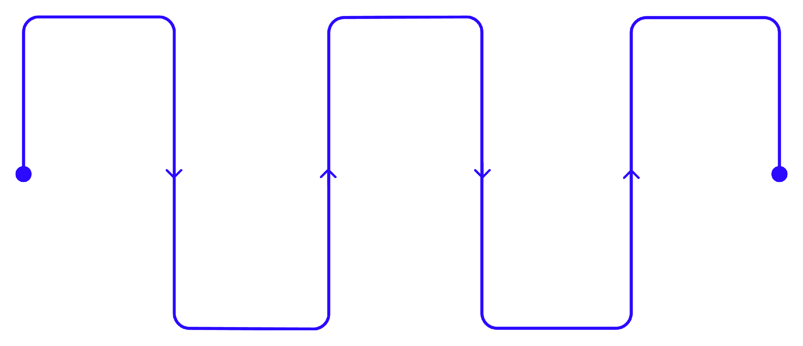
End-to-End Pipeline
From raw question text to validated logical output — every stage is designed for transparency and auditability.
Text
Preprocessing
SPO Triple
Generation
Convert facts into subject- predicate-object
Logical
Validation
Verify consistency and produce verdict
Clean and segment clinical text
Graph Construction
Build knowledge graph for relations
Atomic Fact
Extraction
Identify discrete factual units
The pipeline accepts a clinical question paired with its reasoning text and returns a structured verdict on logical integrity, flagging gaps or unsupported claims at each node.

Slide 4


Atomic Facts
CORE CONCEPT
An atom is the smallest verifiable unit of knowledge — a self-contained, context- free statement that carries exactly one claim.
Example: "Urease hydrolyzes urea" — independent, unambiguous, and verifiable against domain ontology.
Atoms cannot be subdivided without losing meaning. They serve as the foundational building blocks from which all reasoning graphs are constructed.

Slide 5


Atomic Extraction Process
Long, compound reasoning passages are systematically decomposed into minimal, unambiguous statements ready for
structured validation.
Decompose
Break compound sentences into minimal clauses, eliminating conjunctions and embedded dependencies.
Normalize
Standardize medical terminology to ontology-aligned forms, ensuring consistent entity references.
Validate Uniqueness
Confirm each atom carries exactly one clear meaning before storing for downstream processing.

Slide 6
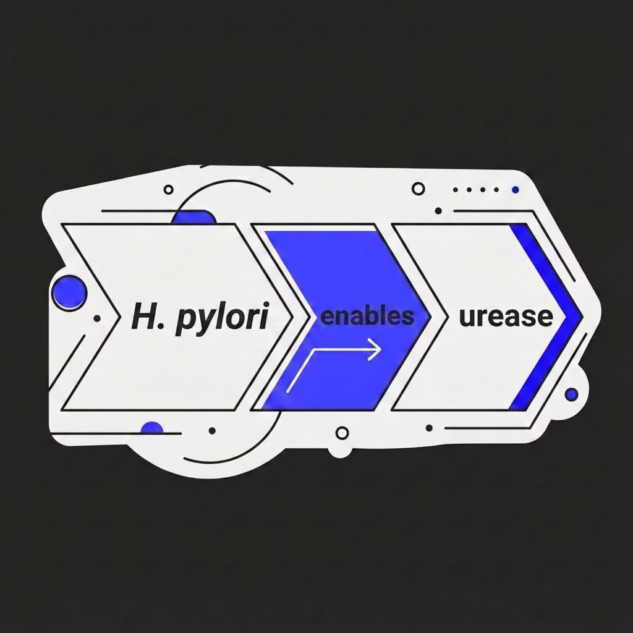


SPO Triples
STRUCTURED REPRESENTATION
Each atomic fact is converted into a standardized Subject
→ Predicate → Object triple — the universal form for machine-readable knowledge representation.
Example Triple:S: H. pylori → P: enables → O:
urease
This normalization strips away linguistic variation, enabling consistent graph-based processing and ontology validation regardless of how the original reasoning was phrased.

Slide 7
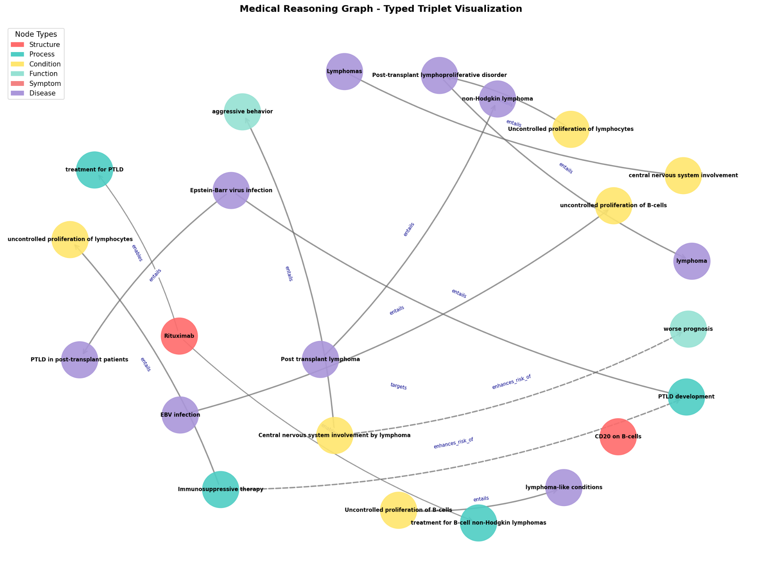
Graph Representation
SPO triples are assembled into a directed knowledge graph — an interpretable structure that mirrors the reasoning chain from clinical premise to diagnostic conclusion.
Nodes
Represent domain entities: bacteria, enzymes, diagnostic tests, clinical findings.
Edges
Directed relationships between entities, derived from predicate assertions in SPO triples.
Traversal
Graph paths enable automated validation of reasoning flow and
detection of disconnected logic.

Slide 8
Reasoning Validation
The validator interrogates the constructed graph against formal logical and ontological criteria before issuing a verdict.
1
Connectivity Check
Verify all concepts are reachable within the reasoning path — no isolated nodes.
2
Flow Integrity
Confirm logical progression from stated premise to conclusion without unexplained jumps.
3
4
Gap Detection
Flag missing intermediate steps that would render the conclusion unsupported.
Claim Rejection
Discard assertions that lack ontological backing or contradict validated domain rules.

Slide 9
Ontology-Guided Accuracy
DOMAIN KNOWLEDGE
The Role of Ontology
The ontology serves as the system's ground truth — a formal specification of valid entities, relationship types, and inference rules within the medical domain.
Defines which entity types can participate in which relationship types
Prevents structurally invalid edges from entering the graph
Anchors validation to accepted biomedical knowledge
Example rule: A bacterium may produce an enzyme —
but an enzyme may not produce a bacterium.
Without ontological constraints, graph edges are syntactically valid but semantically meaningless. The ontology transforms the verifier from a structural checker into a genuine domain reasoner.

Slide 10


Circular Reasoning
A critical failure mode detected by graph traversal — circular reasoning creates a self-referential loop that never reaches independent evidence.
Why It Matters
Detected Pattern:"The urease test works because it detects H. pylori infection."
"H. pylori infection is confirmed because the urease test is positive." No external premise grounds either claim.
Circular arguments yield high surface coherence with zero logical validity. Graph cycle detection flags these structures automatically, preventing them from being accepted as sound medical reasoning.

